Slide 1









DQN Reinforcement Learning
Advancing Deep Q-Networks for Optimal Navigation in Frozen Lake: Evaluating Adaptability and Performance in Dynamic Environments
Aviv Salomon
Ben Gornizky

Slide 2
TABLE OF CONTENTS
01
02
03
04
05
06
Introduction
Architecture
Articles
Environment
Methodology
Project Plans

Slide 3


01
Introduction

Slide 4

History
1992
Q-learning algorithm introduced by Watkins
2013
DQN introduced by DeepMind in the paper 'Playing Atari with Deep Reinforcement Learning' at NIPS
Google DeepMind is a research company owned by Google that focuses on artificial intelligence (AI) and machine learning.
2015
Comprehensive DQN paper 'Human-level control through deep reinforcement learning' published in Nature
2018
Rainbow DQN algorithm introduced, combining several improvements

Slide 5
DQN In A Nutshell
DQN is a reinforcement learning algorithm that combines Q-Learning with deep neural networks to learn how to act in an environment.
Key Concepts:
States: Environment configurations.
Actions: Possible moves.
Rewards: Feedback signals.
Applications: Video games (Atari), robotics, finance (trading strategies).
Advantages: Handles high-dimensional state spaces, effective for complex policy learning.
Challenges: Requires extensive training data, tuning for stability.
Purpose: It aims to enable an agent to make decisions that maximize cumulative rewards over time.

Slide 6
02
Architecture

Slide 7
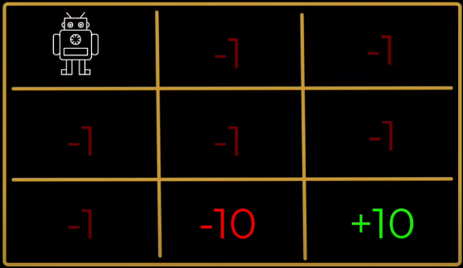
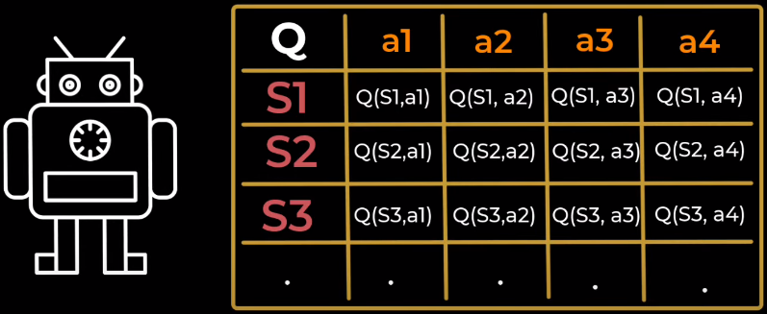
Architecture
RL agents policy (π):
In each State the Agent know which Action to do, based on Q-Table to achieve the maximum Reward
The DQN replace the Q-table with a neural network instead

Slide 8
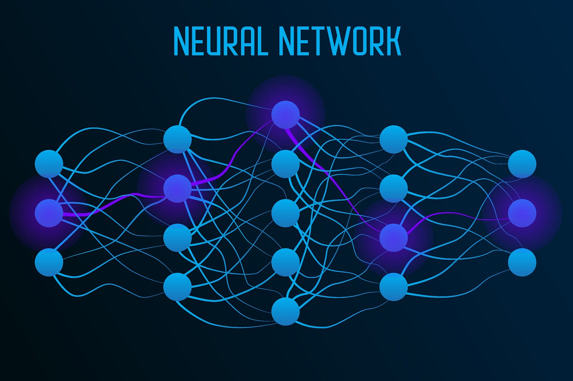
Architecture
DQN:
The DQN Replace Q-Table with NN prediction.
Performing with more robust and scalable solution rather than using a big action-state table
State
Q-Value
Action

Slide 9
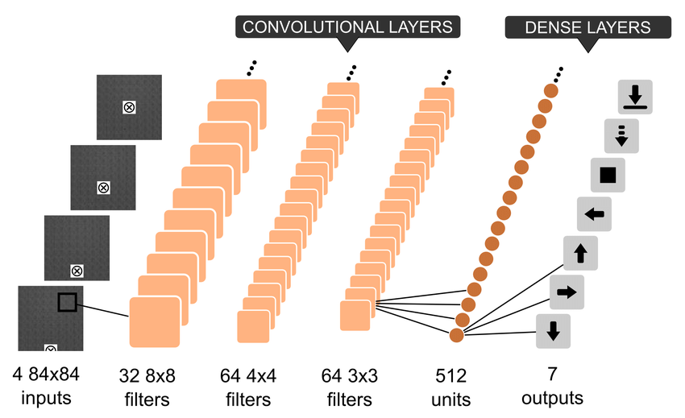
Architecture
Agent & NN
Input Layer:
State representation (game screen pixels)
Convolutional Neural Networks (CNNs):
Extract spatial features from inputs
Fully Connected Layers:
Combine features to predict Q-values
ReLU Activation function
Output Layer:
Q-values for each possible action

Slide 10
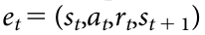
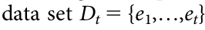
Architecture
Optimal Q action-value function
s - state (observation)
a - action
r - reward
t - index for step
γ - discount
π - policy P(action|state)
The data for the NN
The data is the states and actions that were happened in the environment
e - experience
t - index for step
Dt - collection of e, data set

Slide 11
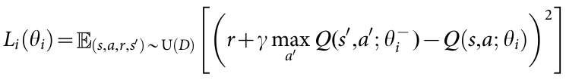
Architecture
Loss function
i - index for iteration
θ - weights
U(D) - unified the data set
s’ - state, s - previous state
a’ - action, a - previous action
r - reward
γ - discount
Q - action-value function
Optimization algorithm
SGD - stochastic gradient descent

Slide 12
03
Articles

Slide 13
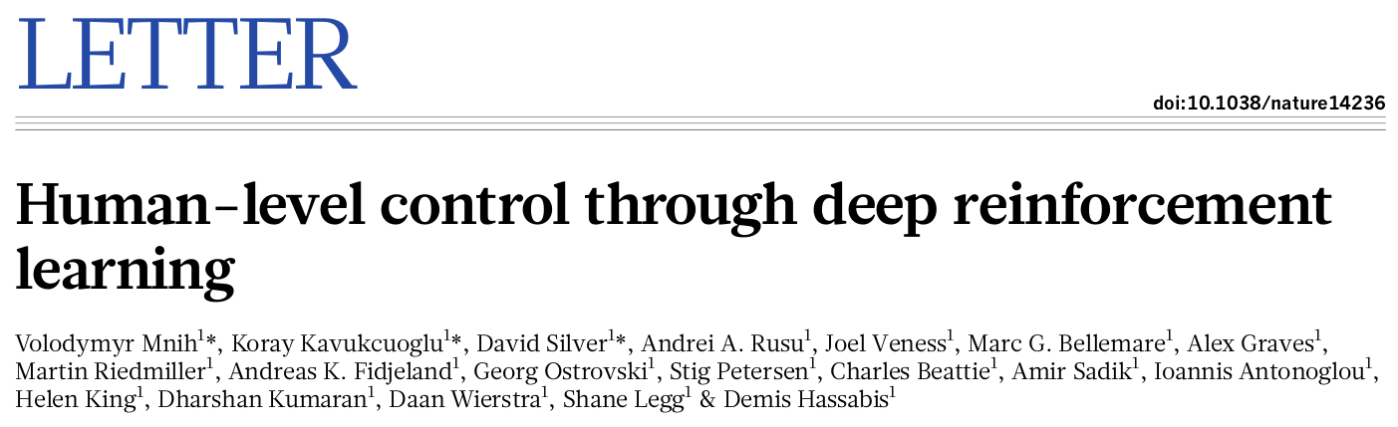
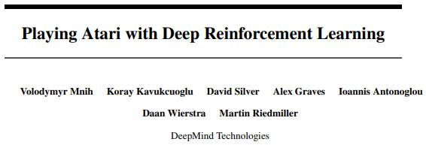
Articles
Human-level control through deep reinforcement learning
Playing Atari with Deep Reinforcement Learning

Slide 14
04
Environment

Slide 15
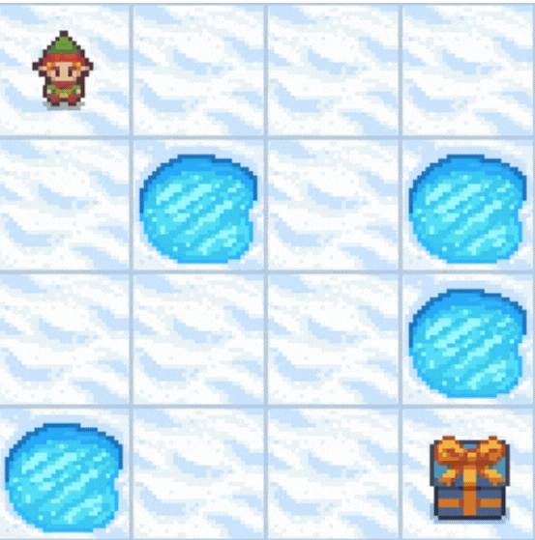
Froze Lake
Game Description:
Frozen Lake is a grid-based game where an agent must navigate from a start point to a goal point on a slippery surface, avoiding holes.
Environment Setup:
Grid Layout: Typically an 𝑛×𝑛 grid (4x4 or 8x8)
S: Start point
G: Goal point
H: Holes (fall into one, and the game is over)
F: Frozen surface (safe to walk on)
Borders:
The grid is bounded, meaning the agent cannot move outside the grid.
Actions attempting to move out of bounds result in no movement.

Slide 16
Froze Lake
4. States and Actions:
States (S): Each cell in the grid represents a unique state.
Actions (A): Four possible actions – left, right, up, down.
Rewards (R):
+1 for reaching the goal.
0 for all other transitions (including falling into a hole).
5. Slippery Surface Dynamics:
Slippery Nature: Due to the slippery surface, actions do not always result in moving to the intended adjacent cell. Instead, there is a chance the agent will slide to an unintended cell, adding randomness to the game and increasing the complexity of navigation.

Slide 17
05
METHODOLOGY

Slide 18
Project Goal
Train an AI agent using Deep Q-Networks (DQN) to navigate the Frozen Lake environment and successfully reach the goal state while avoiding falling into holes.

Slide 19
Topic | OBJECTIVE
Problem Definition | Train DQN agent to navigate Frozen Lake, reaching goal while avoiding holes.
Environment Setup | Define Frozen Lake grid with start, goal, holes, and frozen surfaces.
State and Action Representation | States: Agent's grid position; Actions: Left, right, up, down movements.
DQN Implementation | Use neural network for Q-function approximation.
Training Process | Implement DQN model
Evaluation and Testing | Assess agent's performance: average reward, success rate.
Hyperparameter Tuning | Optimize parameters like learning rate, discount factor.

Slide 20
06
Project Plans

Slide 21



Project Stages
Implement RL: DQN model and Environment
Stage 1
Train and Test RL Model
Stage 2
Collect and Analyze Results
Stage 3

Slide 22





Thanks
Aviv Salomon
avivsalo@gmail.com
Ben Gornizky
bengornizky@gmail.com

